Slide 1



Welcome to
CS 345 Operating Systems
Concurrency, Chapter 6 (13)

Slide 2
Tip #13: Size of Array
To get the size of an array of any data type, use the following macro:
#define NUM_OF(x) (sizeof (x) / sizeof (*x))
int main()
{
int number[10] = {1,1,1,1,1,1};
char *teststr[20] = {"","","","","","","","",""};
printf("Size of number[10] is %d\n", NUM_OF(number));
printf("Size of teststr[20] is %d\n", NUM_OF(teststr));
}
Size of number[10] is 10
Size of teststr[20] is 20
The macro divides the length of the array to the size of its field.

Slide 3
Readers/Writers
Semaphore rmutex=1, wmutex = 1;
integer readcount = 0;
Only one writer at a time
while(true)
{ wait(wmutex);
<write to the data object>
signal(wmutex);
};
The first reader makes sure no one can write
Writer ⇨
while(true)
{ wait(rmutex);
readcount++;
if (readcount == 1) wait(wmutex);
signal(rmutex);
<read the data>
wait(rmutex);
readcount--;
if (readcount == 0) signal(wmutex);
signal(rmutex);
};
Readers have priority!
(writers subject to starvation!)
Who has priority
Reader or Writer?
Reader ⇨
Last one out allows writing again
More than one reader at a time

Slide 4
Writers/Readers
Semaphore outerQ, rsem, rmutex, wmutex, wsem = 1;
while(true)
{ wait(outerQ);
wait(rsem);
wait(rmutex);
readcnt++
if (readcnt == 1)
wait(wsem);
signal(rmutex);
signal(rsem);
signal(outerQ);
READ
wait(rmutex);
readcnt--;
if(readcnt == 0)
signal(wsem);
signal(rmutex);
};
while(true)
{ wait(wmutex);
writecnt++;
if (writecnt == 1)
wait(rsem);
signal(wmutex);
wait(wsem);
WRITE
signal(wsem);
wait(wmutex);
writecnt--;
if (writecnt == 0)
signal(rsem);
signal(wmutex);
};
Additional readers queue here allowing writers to jump ahead of the readers
6
Once a writer wants to write – no new readers allowed
3
Disable writers
1
Wait here until all readers done,
as well as multiple writers
4
Last reader out allows writers
5
2
Last writer out allows readers
Notes:
Writer’s priority is much more difficult! This demonstrates a very import pattern.
rmutex – protects incrementing readcnt
rsem – stops readers when writers want to go.
outer – allows writers to jump ahead of the readers
writer doesn’t have to wait on reader’s queue – wait at most on 1 reader.
rsem limits the number of readers
What about letting 4 in? Change outer to 4
Again, semaphores must have FIFO queues!!!
A writer can jump in anytime.

Slide 5
Barbershop Problem
3 barbers, each with a barber chair
Haircuts vary in time
Sofa can hold 4 customers
Maximum of 20 in shop
Customers arrive randomly
Customers wait outside if necessary
When a chair is empty:
Customer sitting longest on sofa is served
Customer standing the longest sits down
After haircut, customer pays cashier at cash register
Barbers have to cut hair and cashier
Customer waits for receipt
Upon exit, new customer allowed in shop
Barber chairs
Cashier
Entrance
Standing
room area
Exit
Sofa

Slide 6
Fair Barbershop
procedure customer;
var custnr: integer;
begin
wait ( max_capacity );
// enter_shop
wait( mutex1 );
count := count + 1;
custnr := count;
signal( mutex1 );
wait( sofa );
// sit on sofa
wait( barber_chair );
// get up from sofa
signal( sofa );
// sit in barber chair
wait( mutex2 );
enqueue1( custnr );
signal( cust_ready );
signal( mutex2 );
wait( finished[custnr] );
// leave barber chair
signal( leave_b_chair );
// pay
signal( payment );
wait( receipt );
// exit shop
signal( max_capacity );
end;
procedure barber;
var b_cust: integer
begin
repeat
// get customer
wait( cust_ready );
wait( mutex2 );
dequeue1( b_cust );
signal( mutex2 );
wait( coord );
// cut hair
signal( coord );
signal( finished[b_cust] );
wait( leave_b_chair );
signal( barber_chair );
forever
end;
Barber chairs
Cashier
Entrance
Standing
room area
Exit
Sofa
max_capacity: semaphore (:=20);
sofa: semaphore (:=4);
barber_chair, coord: semaphore (:=3);
mutex1, mutex2: semaphore (:=1);
cust_ready, leave_b_chair: semaphore (:=0)
payment, receipt: semaphore (:=0)
finished: array [1..50] of semaphore (:=0);
count: integer;
procedure cashier;
begin
repeat
wait( payment );
wait( coord );
// accept payment
signal( coord );
signal( receipt );
forever
end;

Slide 7

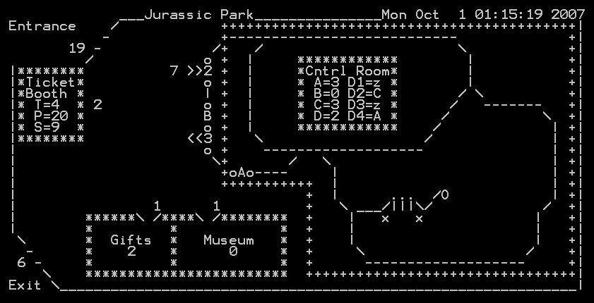
Lab 03: Jurassic Park
Visitors try to enter the Jurassic Park at random times. (Only a set number of visitors may be in the park at any one time – OSHA requirements!)
When the touring car is filled with visitors and a driver is obtained, the car enters Jurassic Park and runs a guided tour through the park.
Upon being allowed in the park, a visitor must get in line to purchase a ticket.
When the tour car pulls into the unloading station, the visitors exit the tour car. and the driver goes to sleep awaiting new duties. The tour car pulls forward to be loaded again.
After visiting the museum, the visitor gets in the tour car line to wait until permitted to board a tour car. (As a visitor boards a tour car, he returns his ticket.)
After successfully obtaining a ticket from a driver, the visitor gets in the museum line and visits the museum. (A limited number of visitors are allowed in the museum as well as the gift shop.)
After the visitors exit a tour car, they get into the gift shop line until they can visit the gift shop.
After visiting the gift shop, the visitors exit the park.

Slide 8
Jurassic Park
procedure visitor;
var visitor_id: integer;
begin
wait ( max_capacity );
// enter_park
wait ( parkMutex );
numOutsidePark--;
numInPark-++;
signal ( parkMutex );
// get a ticket
wait ( requestTicketMutex );
signal ( needTicket );
signal ( wakeupDriver );
wait ( takeTicket );
signal ( requestTicketMutex );
// visit museum
// get in car line
// wait for a seat
wait ( need_visitor );
signal ( visitor_ready );
pass_to_car ( visitor_id );
wait ( ride_over );
// give back ticket
// visit gift shop
// exit park
signal ( max_capacity );
end;
procedure car;
var carID: integer
begin
repeat
// fill 3 car seats
for (NUM_SEATS)
{ wait ( fillSeat[carID] );
signal ( need_visitor );
wait ( visitor_ready );
save_Visitor( visitorID );
signal ( seatFilled[carID] );
}
pass_to_park( carDone );
signal ( carReady );
// enjoy ride
wait ( carDone );
signal ( each visitorID );
forever
end;
max_capacity: semaphore (:=20);
parkMutex, requestTicketMutex: semaphore (:=1);
needTicket, waitTicket: semaphore (:=0)
procedure driver;
var carID: integer
begin
repeat
wait ( wakeupDriver );
if ( trylock ( need_ticket ) )
{ signal (takeTicket); }
else
{ signal ( driver_ready );
wait ( ride_over );
{
forever
end;

Slide 9
Message Passing
Shared memory is useful in a threaded environment
Single atomic variables (semaphores, modes)
Memory mapping (data structures, messages)
Test-and-set (atomic instructions)
Fast – do not require data movement (reference)
Inter-process communication (IPC) used by processes
for processes inside the same computer
for processes in a distributed system
Message passing used by distributed systems (networks)
send(destination, message)
post(destination, message)
receive(source, message)
Notes:
9

Slide 10
Synchronization
For the sender: it is more natural not to be blocked
can send several messages to multiple destinations
sender usually expects acknowledgment of message receipt (in case receiver fails)
PostMessage() is asynchronous – returns immediately
SendMessage() is synchronous –block until message delivered and processed
For the receiver: it is more natural to be blocked after issuing ReceiveMessage()
the receiver usually needs the info before proceeding
but could be blocked indefinitely if sender process fails before sending reply
Notes:
10

Slide 11
Addressing
Middleware:
Software that acts as a bridge between an operating system or applications, especially on a network.
Direct addressing:
When a specific process identifier is used for source/destination
But what about late binding (ie., a print server)?
Indirect addressing (more convenient):
Messages are sent to a shared mailbox (queue of messages)
Senders put messages in mailbox (produce), receivers pick them up (consume)
A mailbox facilitates message deliveries
A mailbox can be private - one sender/receiver pair
A mailbox can be shared among several senders and receivers - OS may then allow the use of message types (for selection)
A mailbox port associates one receiver with multiple senders - used for client/server application: the receiver is the server
Notes:
11

Slide 12
Port/Mailbox Ownership
A port is usually owned and created by the receiving process
The port is destroyed when the receiver terminates
The OS creates a mailbox on behalf of a process (which becomes the owner)
The mailbox is destroyed at the owner’s request or when the owner terminates
Notes:
12

Slide 13
Monitors
In concurrent programming (also known as parallel programming), a monitor is a programming-language synchronization construct that provides equivalent functionality to that of semaphores.
ME threads that wait (block) for true conditions.
Thread-safe class (wrapped by mutual exclusive conditions)
Concurrent Pascal, Pascal-Plus, Modula, Java
A monitor is a software module containing:
one or more procedures, an initialization sequence, and local data variables
Mutex (lock) object and condition variables
Condition variable:
Container of threads that are waiting on a certain condition.
Threads temporarily give up exclusive access in order to wait for some condition to be met.
Local variables accessible only by monitor’s procedures
A process enters the monitor by invoking one of its procedures
Only one process can be in the monitor at any one time
Notes:
13
Need to give someone in the monitor preference to someone waiting to get into the monitor.
Check urgent queue first.
How is it implemented? Semaphores
Wrap semaphore in procedure call (wait on entry)
Signal when leaving – BUT need to look in urgent queue first, if empty, signal entry queue.
Each conditional variable is a semaphore
cwait – needs to check the urgent queue first
csignal – may have to move condition variable semaphore to urgent queue.
Good or bad?? Could be more restrictive than just using semaphores.

Slide 14
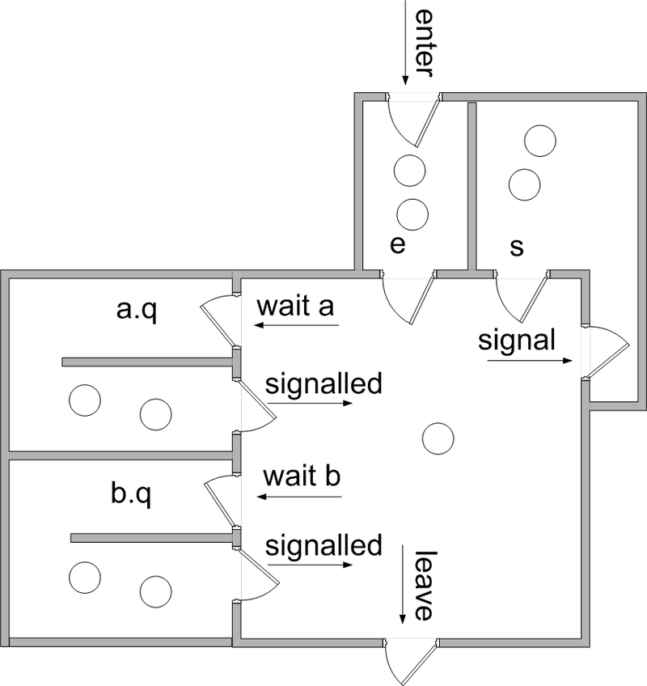
Hoare Monitor Example
With a blocking condition variable, the signaling thread must wait outside the monitor (at least) until the signaled thread relinquishes occupancy of the monitor by either returning or by again waiting on a condition variable.
Monitors using blocking condition variables are often called Hoare-style monitors or signal-and-urgent-wait monitors.
We assume there are two queues of threads associated with each monitor object
e is the entrance queue
s is a queue of threads that have signaled.
All queues are typically guaranteed to be fair and, in some implementations, may be guaranteed to be first in first out.
Each operation runs in mutual exclusion to the others; thus, restarted threads do not begin executing until the operation is complete.)
A Hoare style monitor with two condition variables a and b.

Slide 15
Monitor for the P/C problem
Monitor boundedbuffer:
buffer: array[0..k-1] of items;
nextin:=0, nextout:=0, count:=0: integer;
notfull, notempty: condition;
Produce(v):
if (count = k) cwait(notfull);
buffer[nextin] := v;
nextin := nextin+1 mod k;
count++;
csignal(notempty);
Consume(v):
if (count = 0) cwait(notempty);
v := buffer[nextout];
nextout := nextout+1 mod k;
count--;
csignal(notfull);
Make threading system
release all locks;
sleep until condition is met.
Signal a consumer thread
or all consumer threads
that are blocked waiting for
non-empty buffer.
Notes:
15

Slide 16
Conclusion
Semaphores are a powerful tool for enforcing mutual exclusion and to coordinate processes.
When wait(S) and signal(S) are scattered among several processes
Difficult to understand their effects.
Difficult to test.
Monitors make classes thread-safe and mutual exclusion more controllable.
Usage must be correct in all the processes (everyone has to play by the rules).
One bad (or malicious) process can fail the entire collection of processes

Slide 17
Delta Clock
Problem: How to efficiently monitor multiple timed events?
Examples of timed events:
scheduling
real-time sequencing
timers
timeouts
Lists require each event timer to be decremented (O(n)) to determine if time has expired.
Using a Delta Clock only requires decrementing the top entry (O(1)).

Slide 18
DC Implementation
Notice that Event1 occurs 15 tics after Event2
Suppose:
Event1 occurs in 20 tics
Event2 occurs in 5 tics
Event3 occurs in 35 tics
Event4 occurs in 27 tics
Event 5 occurs in 27 tics
Event 6 occurs in 22 tics
20
Event1
5
Event2
5
Event2
35
Event3
12
Event7
5
Event2
3
Event1
12
Event7
5
Event2
27
Event4
2
Event6
3
Event1
15
Event1
5
Event4
2
Event6
2
Event6
27
Event5
0
Event5
5
Event4
5
Event4
And that Event6 occurs 2 tics after Event1
4
Event8
0
Event5
0
Event5
4
Event3
22
Event6
8
Event3
8
Event3
Linked List
Delta Clock
What if Event7 occurs in 17 tics?
Event8 in 31 tics?

Slide 19
Lab 03 Step 1: Delta Clock
Implement delta clock.
Design data structure to hold delta times/events.
Program an insert delta clock function
insertDeltaClock(int time, Semaphore* sem);
High priority, mutex protected
Add 1/10 second function to decrement top event and semSignal semaphore when 0
pollinterrupts or
High priority, mutex protected.
dc[5]
dc[4] | 10 / sem1
dc[3] | 5 / sem2
dc[2] | 0 / sem3
dc[1] | 2 / sem4
dc[0] | 4
Thoroughly test the operation of your delta clock before proceeding.
os345p3.c
Print Delta Clock (dc): int P3_dc(int argc, char* argv[]);
Test Delta Clock (tdc): int P3_tdc(int argc, char* argv[]);
int dcMonitorTask(int argc, char* argv[]);
int timeTask(int argc, char* argv[]);

Slide 20

Chapter 6 Concurrency: Deadlock and Starvation

Slide 21
Chapter 6 Concurrency: Deadlock and Starvation

Slide 22
CS 345
Stalling’s Chapter | # | Project
1: Computer System Overview 2: Operating System Overview | 4 | P1: Shell
3: Process Description and Control 4: Threads | 4 | P2: Tasking
5: Concurrency: ME and Synchronization 6: Concurrency: Deadlock and Starvation | 6 | P3: Jurassic Park
7: Memory Management 8: Virtual memory | 6 | P4: Virtual Memory
9: Uniprocessor Scheduling 10: Multiprocessor and Real-Time Scheduling | 6 | P5: Scheduling
11: I/O Management and Disk Scheduling 12: File Management | 8 | P6: FAT
Student Presentations | 6

Slide 23
Learning Objectives…
Learning Outcomes
After completing this section, you should be able to
List and explain the conditions of deadlock.
Define deadlock prevention and describe deadlock prevention strategies related to each of the conditions for deadlock.
Explain the difference between deadlock prevention and deadlock avoidance.
Understand how an integrated deadlock strategy can be designed.
Analyze the dining philosophers problem.
Explain the concurrency and synchronization methods used in UNIX, Linux, Solaris, and Windows 7.
Topics
Resources
Deadlock
Joint Process Diagrams
Deadlock Conditions
Circular Wait
Resource Allocation Graph
Handling Deadlock
Avoidance
Detection
Recovery

Slide 24
Quiz 6.1
How could deadlock occur when
200K bytes of memory is available for allocation by the system
Process 1 needs 140K in 80K, 60K blocks
Process 2 needs 150k in 70K, 80K blocks
Process 1
Request 80K bytes
…
Request 60K bytes
…
Process 2
…
Request 70K bytes
…
Request 80K bytes
How could deadlock occur when
Two processes need to communicate via send/receive messages
Process 1 waits to hear from process 2 before sending data
Process 2 proceeds after hearing from process 1
Process 1
Receive(P2)
…
Send(P2)
…
Process 2
…
Receive(P1)
…
Send(P1)
Notes:
24

Slide 25
Types of Resources
Reusable Resources
Used by one process at a time and not depleted by that use
Processes obtain resources that they later release for reuse by other processes
Processor time, I/O channels, main and secondary memory, files, databases, and semaphores
Deadlock occurs if each process holds one resource and requests the other
Consumable Resources
Created (produced) and destroyed (consumed) by a process
Interrupts, signals, messages, and information in I/O buffers
Deadlock may occur if a Receive message is blocking
May take a rare combination of events to cause deadlock
Notes:
25

Slide 26
Follow the Rules…
System Model (Rules)
Process must request (and be granted) a resource before using it.
Process must release the resource when done.
Why??
Deadlock
A set of processes is in a deadlock state when every process in the set is waiting for an event that can only be caused by another process in the set.
P1: holds R1, needs R2
P2: holds R2, needs R3
P4: needs R1
P3: holds R3, needs R1
Notes:
26

Slide 27
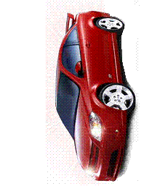







Quiz 6.2
What are the resources?
Where is mutual exclusion needed?
What is required for deadlock to occur?
Notes:
27

Slide 28
Quiz 6.2 (solution)
What are the resources?
Where is mutual exclusion needed?
What is required for deadlock to occur?
ME
Notes:
28

Slide 29
Joint Process Diagram
Progress
of Q
1
2
Impossible joint
conditions are
grayed out.
Release A
Both P and Q
have A
A
Required
Release B
Get A
B
Required
5
?
Both P and Q
have B
P has B
Q has A
P has B
Q has A
4
Get B
Deadlock is only inevitable if the joint progress of the two processes creates a path that enters the fatal region.
6
3
Progress
of P
Get A
Get B
Release A
Release B
A Required
B Required
Notes:
29

Slide 30
Joint Process Diagram
Progress
of Q
1
2
3
Release
A
Both
P and Q
have A
6
A
Required
Release
B
Get A
Both
P and Q
have B
B
Required
5
Get B
4
Progress
of P
Get A
Release A
Get B
Release B
No fatal region, as there are “exit” paths available.
A
Required
B
Required
Notes:
30

Slide 31
Conditions of Deadlock
Necessary (but not sufficient)
Mutual exclusion – Everyone abides by the rules
only one process may use a resource at a time.
no process may access resource allocated to another.
Hold-and-wait
a process may hold allocated resources while awaiting assignment of other resources.
No preemption
no resource can be forced to free a resource.
Circular wait (sufficient)
a closed chain of processes exists, such that each process holds at least one resource needed by the next process in the chain (consequence of the first three conditions)
Other conditions are necessary but not sufficient for deadlock - all four conditions must hold for deadlock - Unresolvable circular wait is the definition of deadlock!
Notes:
31

Slide 32
Circular Wait
Resource
A
Requests
Held by
Process
P1
Process
P2
Held By
Requests
Resource
B
Notes:
32

Slide 33
Resource Allocation Graph
R1
R2
Deadlocks can be described using resource allocation graph.
Vertices: circles are Processes, rectangles are Resources.
P1
P2
P3
A directed edge from Pi to Rj indicates process Pi has requested an instance of resource Rj
R3
A directed edge from Rj to Pi indicates resource Rj has been allocated to process Pi
R4
Notes:
33

Slide 34
Resource Allocation Graph
R1
R2
Is there a cycle (ie. some number of vertices connected in a closed chain)?
P1
P2
P3
If a graph contains no cycles, then no process in the system is deadlocked.
If the graph contains a cycle, deadlock MAY exist.
R3
Yes
Is there deadlock?
R4
Notes:
34

Slide 35
Deadlock?
P2
Is there a cycle?
Yes
R1
P1
P3
Is there deadlock?
No
R2
P4
Notes:
35

Slide 36
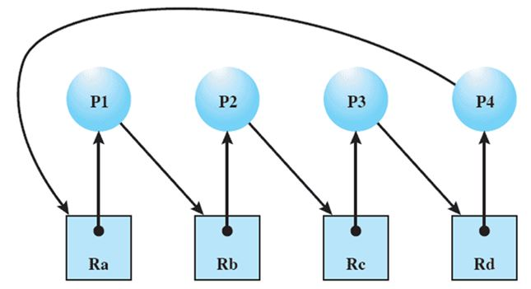
Traffic Intersection

Slide 37
Handling Deadlock
Four general approaches exist for dealing with deadlock.
Prevent deadlock
by adopting a policy that eliminates one of the conditions.
Avoid deadlock
by making the appropriate dynamic choices based on the current state of resource allocation.
Detect Deadlock
by checking whether conditions 1 through 4 hold and take action to recover.
Ignore Deadlock
System may hang, so??
Notes:
37

Slide 38
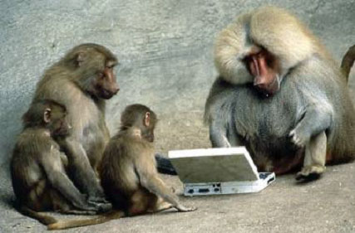

Be Safe

